Slide 1

Predict and Optimize Product Backorders
Team 6: Yen Hoang, Cuong Nguyen, Muzi Chen

Slide 2
Business Understanding – Overview
Business Understanding | Data Understanding | Data Quality & Preparation | Modeling | Evaluation | Recommendations
Although backorder means there is healthy demand for a product, not all customers have the patience and luxury of waiting for future stock to arrive. This classic inventory management problem could be seen as two-fold:
shortage: missing orders, customers dissatisfaction, loss of revenue/loyalty
redundancy: loss of shelf space, increased inventory costs, less lean
Our aim: predict the likelihood of backorder and the time necessary to readjust inventory

Slide 3
Data Understanding – Variables
Business Understanding | Data Understanding | Data Quality & Preparation | Modeling | Evaluation | Recommendations
Variables | Description | Value | Type | Action
sku | Random ID for the product | -- | Categorical | Remove
national_inv | Current inventory level for the part | -27256 to 12334404 | Continuous | --
lead_time | Transit time for product | 0 to 52 | Continuous | --
in_transit_qty | Amount of product in transit from source | 0 to 489408 | Continuous | --
min_bank | Minimum recommend amount to stock | 0 to 313319 | Continuous | --
potential_issue | Source issue for part identified | Yes/No | Flag | Change to 1/0
pieces_past_due | Parts overdue from source | 0 to 146496 | Continuous | --
source performance | Source performance for prior 6, 12 month period | -99 to 1 | Continuous | --
local_bo_qty | Amount of stock orders overdue | 0 to 12530 | Continuous | --
deck_risk, oe_constraint, ppap_risk, stop_auto_buy, rev_stop | Part risk flag | Yes/No | Flag | Change to 1/0
forcast | Forecast sales for the next 3, 6, 9 months | 0 tp 3777304 | Continuous | --
sales | Sales quantity for the prior 1,3,6,9 month time period | 0 to 2146625 | Continuous | --
Went_on_backorder (Target value) | Product actually went on backorder | Yes/No | Flag | Change to 1/0

Slide 4
Data Understanding – Descriptive Analysis 1
Business Understanding | Data Understanding | Data Quality & Preparation | Modeling | Evaluation | Recommendations

Slide 5
Data Quality & Preparation
Business Understanding | Data Understanding | Data Quality & Preparation | Modeling | Evaluation | Recommendations
Datasets severely imbalanced Rebalance datasets
Missing values (*NA*) in ‘lead_time’ variable Remove *NA*
Outliers (with the values = -99) in ‘perf_6_month_avg’ and ‘perf_12_month_avg’ variables Remove outliers
Remove ‘sku’ variable, change ‘Yes/No’ values to 1/0
Prepare a validation set

Slide 6
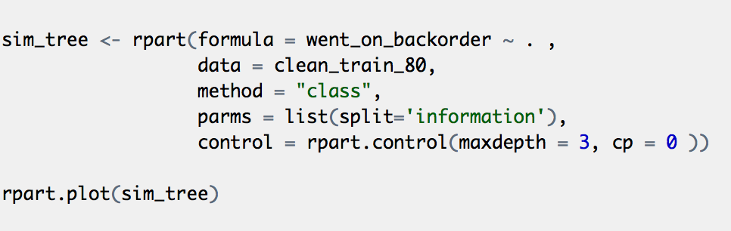
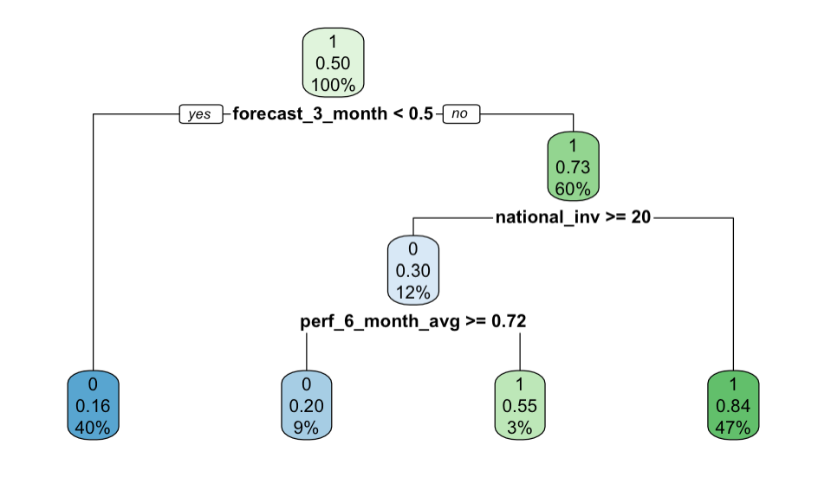
Modeling 1 – Simple Decision-Tree
Business Understanding | Data Understanding | Data Quality & Preparation | Modeling | Evaluation | Recommendations
 | Confusion Matrix
 | 0 | 1
0 | 135550 | 27712
1 | 29826 | 139633
(rows show prediction)
Three most important predictors
forecast sales for next 3 months
current inventory level for the part
source performance for prior 6 months

Slide 7
Modeling 2 – Auto Classification
Business Understanding | Data Understanding | Data Quality & Preparation | Modeling | Evaluation | Recommendations

Slide 8
Modeling 3 –
Business Understanding | Data Understanding | Data Quality & Preparation | Modeling | Evaluation | Recommendations

Slide 9
Modeling 4 –
Business Understanding | Data Understanding | Data Quality & Preparation | Modeling | Evaluation | Recommendations

Slide 10
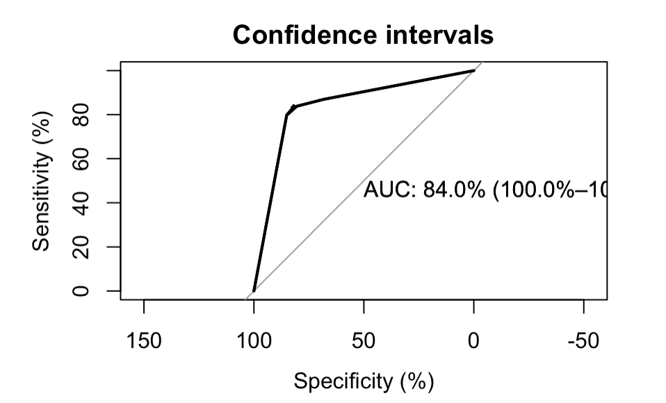
Evaluation
Business Understanding | Data Understanding | Data Quality & Preparation | Modeling | Evaluation | Recommendations

Slide 11
Recommendation
Business Understanding | Data Understanding | Data Quality & Preparation | Modeling | Evaluation | Recommendation

